Slide 1
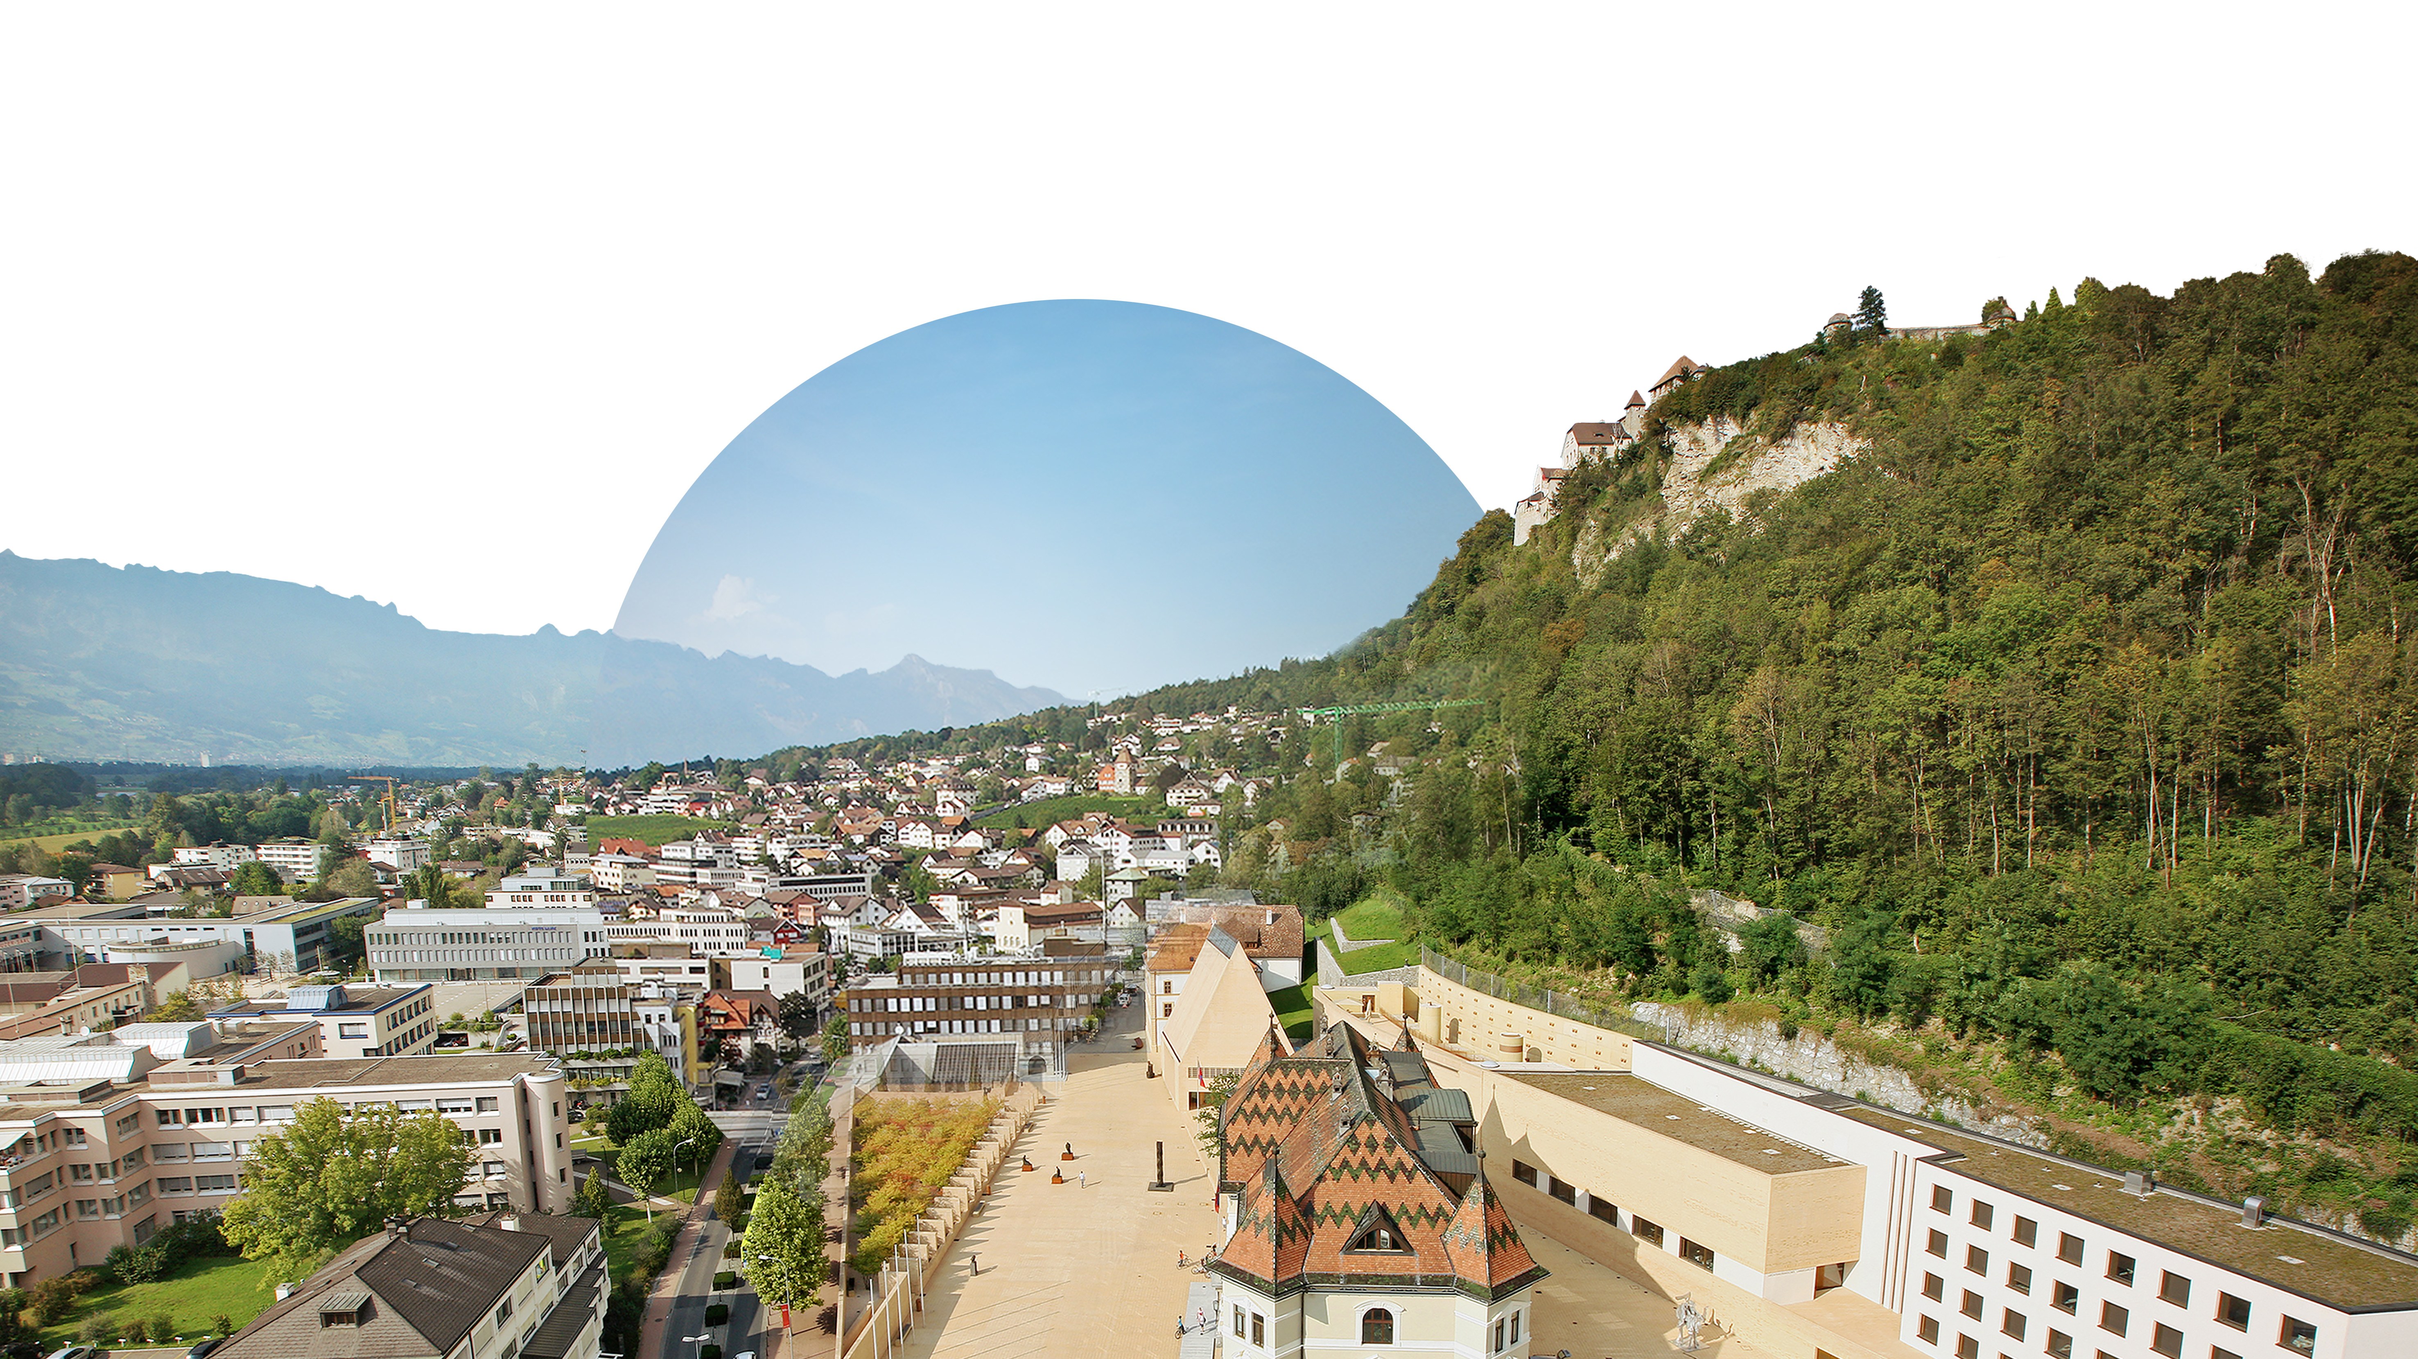
Thinking in generations
Presenting the Liechtenstein
financial centre

Slide 3
Form of government The Principality is a constitutional hereditary monarchy on a democratic and parliamentary basis.
39 308 inhabitants
Liechtenstein’s population has increased
more than four-fold over the past 100 years.
Prince On 15 August 2004, Prince Hans-Adam II abdicated and appointed his son, Hereditary Prince Alois as the new head of state.
5 government members The country’s supreme executive body consists of the prime minister and four ministers.
160 km² Liechtenstein’s borders and consequently
its surface area have remained practically
unchanged for 300 years. 42 % of the total surface area or 68 km² is forest.
25 members of parliament Liechtenstein’s parliament is also called the «Landtag» or «Hohes Haus».
11 municipalities Liechtenstein’s settlements are divided into two electoral districts, known as the «Oberland» (Vaduz, Triesen, Balzers, Triesenberg, Schaan, Planken) and the «Unterland» (Eschen-Nendeln, Mauren-Schaanwald, Gamprin-Bendern, Ruggell, Schellenberg).
41 352 jobs Liechtenstein has more positions of employment than inhabitants. Each day over 20 000 people commute to the Principality for work.
1:8 In Liechtenstein, the ratio between economically
active companies and inhabitants is about 1 : 8 (in CH approx. 1 : 14 and in DE some 1 : 24).
Swiss francs
Liechtenstein made the Swiss franc
(CHF) its legal tender on 26 May 1924.
German Liechtenstein’s official and national language is German.

Slide 4
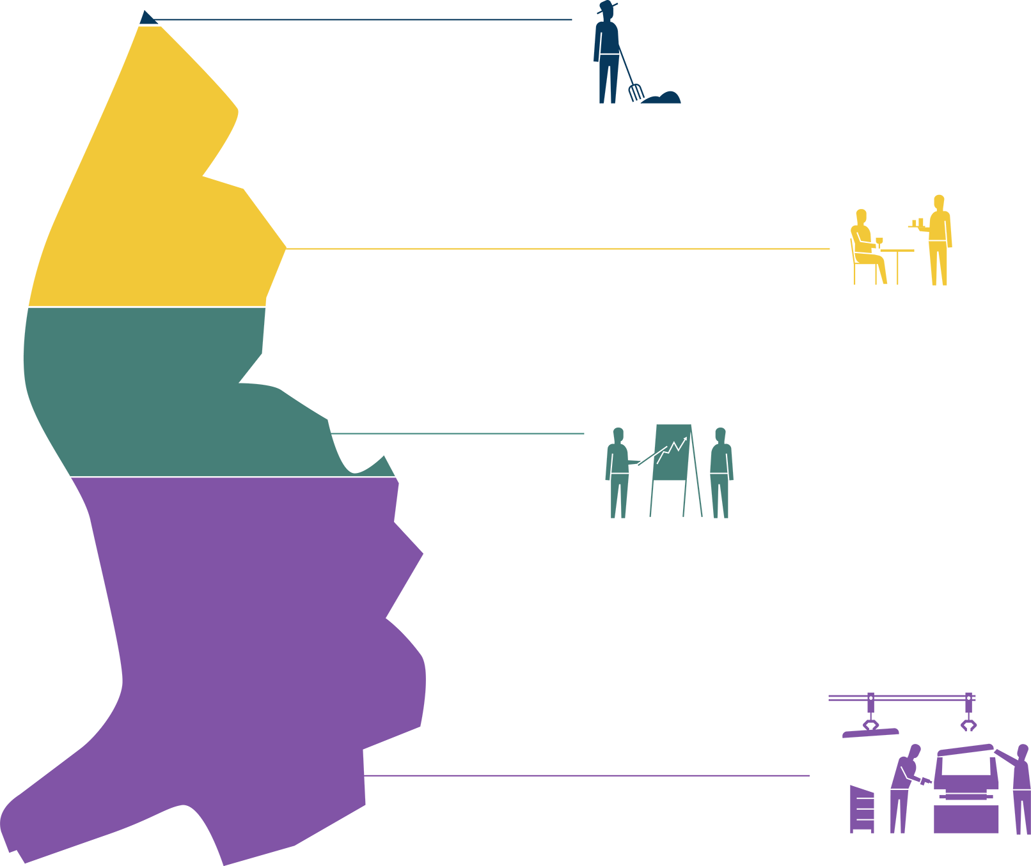
Broadly diversified business centre with stable industrial and financial sector
0,2 %
agriculture
37 %
general services
21 %
financial services
42 %
industrial

Slide 5
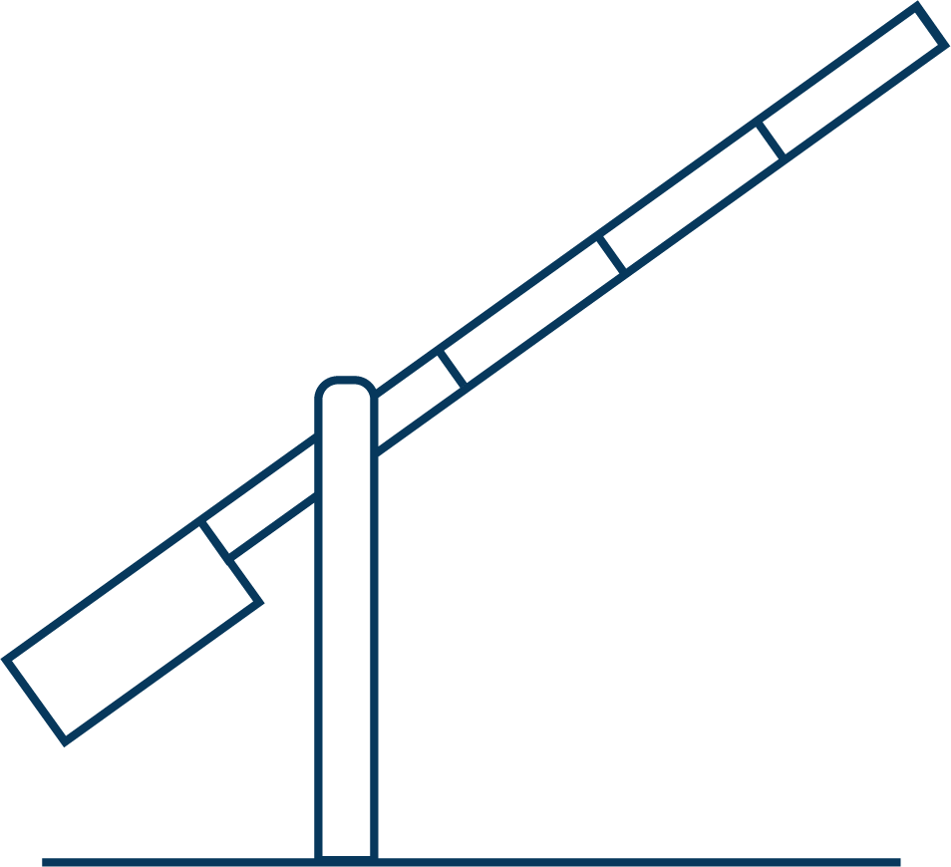
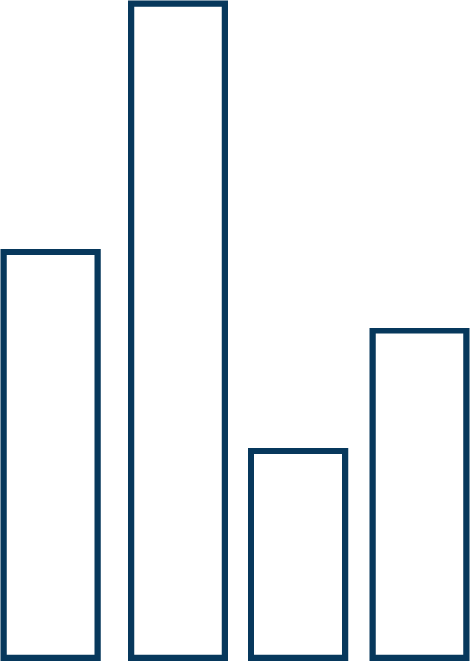
Broadly diversified business centre with stable industrial and financial sector
Customs union
Liechtenstein is part of the Swiss customs territory. In addition to the customs union, there are over 100 further bilateral treaties with Switzerland.
Market access
Liechtenstein-based companies have unrestricted market access to 29 states and around 450 million people in Europe.
Stability and continuity
A stable social, legal and economic system ensures a high degree of of continuity and legal certainty.
22,6 % public expenditure ratio
Liechtenstein has the lowest public expenditure ratio (government spending in relation to GDP) of all European countries. In Switzerland the ratio is in the region of 30 %, in Austria at over 50 %.
Blockchain in Liechtenstein
Legal certainty promotes innovation and reduces risks for all parties. That is why the Token and VT Service Providers Act (“TVTG”) was introduced on
1 January 2020.
AAA-Rating
Liechtenstein has no government debt and is regularly awarded an AAA country rating by Moody’s and Standard & Poor’s.

Slide 6
Professional, innovative, internationally-recognised and broadly based Liechtenstein financial centre
11
32
94
92
22
banks
insurance
companies
asset management
companies
auditors
TT service provider
136
858
217
1375
93
fiduciaries
single- and
sub-funds
fiduciary
companies
common-benefit
foundations
Chartered Financial Analysts

Slide 7
Perfect combination of innovation and a long-term mindset
QUALITY AND
STRENGTH OF INNOVATION
STABILITY AND
LEGAL CERTAINTY
LEGAL AND
TAX CONFORMITY
SUSTAINABILITY AND
PHILANTHROPY
Notes:
QUALITY AND
STRENGTH OF INNOVATION
• Extensive expertise and long-standing experience of service providers within the financial centre
• Direct access to specialists and experts from Switzerland, Austria, Germany and Liechtenstein
• Flexibility and short decision-making channels in Liechtenstein
• Europe-compliant niche products in the financial sector
• Support for innovation
STABILITY AND
LEGAL CERTAINTY
• Stable social, legal and economic system
• Customs and currency union with Switzerland since 1924
• Member of the European Economic Area (EEA) since 1995.
• Barrier-free access to the European market (freedom of movement of goods, people, services and capital)
• Political continuity and stability
• Liberal economic policies
• Liberal company law
• Sound financial policies / no government debt
• Very well-funded public sector
• Moderate corporate taxation
• AAA country rating awarded by Moody’s and Standard & Poor’s
• Broadly diversified economy with strong industrial sector
LEGAL AND
TAX CONFORMITY
• Financial centre regulation in Liechtenstein based on EU guidelines
• Internationally integrated and recognised financial market supervisory authority
• Recognition and implementation of international and European tax cooperation standards
• Early AEOI adopter (automatic exchange of information)
• Global Forum rating “largely compliant”
• Implementation of OECD / BEPS (corporate taxation guidelines)
• Tax information exchange agreements and / or double taxation agreements with 54 states
SUSTAINABILITY AND
PHILANTHROPY
• Liechtenstein is establishing itself as a respected, sustainable and stable financial centre.
• Acting in a responsible, sustainable manner is a central component of Liechtenstein’s culture.
• Unique projects:
• “Energy country”: all of Liechtenstein’s municipalities have been awarded the “Energy Town” label. Liechtenstein is the world’s first “energy country”.
• “Solar world champion”: Liechtenstein has the highest per capita photovoltaic capacity.
• “Water footprint”: Liechtenstein is the first country to offer as many people in developing countries safe access to clean drinking water as it has inhabitants.
• Outstanding international reputation as a philanthropy centre at the heart of Europe.
• Advanced foundation governance with high protection of the private sphere.

Slide 8
Perfect combination of innovation and a long-term mindset
QUALITY AND STRENGTH OF INNOVATION
Extensive expertise and long-standing experience of service providers within the financial centre
Direct access to specialists and experts from Switzerland, Austria, Germany and Liechtenstein
Flexibility and short decision-making channels in Liechtenstein
Europe-compliant niche products in the financial sector
Support for innovation
Close cooperation between authorities, regulators and financial centre players
Governmental Office for Financial Innovation and Digitalisation
QUALITY AND
STRENGTH OF INNOVATION

Slide 9
Perfect combination of innovation and a long-term mindset
STABILITY AND LEGAL CERTAINTY
Stable social, legal and economic system
Customs and currency union with Switzerland since 1924
Member of the European Economic Area (EEA) since 1995.
Barrier-free access to the European market (freedom of movement of goods, people, services and capital)
Political continuity and stability
Liberal economic policies
Liberal company law
Sound financial policies / no government debt
Very well-funded public sector
Moderate corporate taxation
AAA country rating awarded by Moody’s and Standard & Poor’s
Broadly diversified economy with strong industrial sector
STABILITY AND
LEGAL CERTAINTY

Slide 10
Perfect combination of innovation and a long-term mindset
LEGAL AND TAX CONFORMITY
Financial centre regulation in Liechtenstein based on EU guidelines
Internationally integrated and recognised financial market supervisory authority
Recognition and implementation of international and European tax cooperation standards
Early AEOI adopter (automatic exchange of information)
Global Forum rating “largely compliant”
Implementation of OECD / BEPS (corporate taxation guidelines)
Tax information exchange agreements and / or double taxation agreements with 54 states
LEGAL AND
TAX CONFORMITY

Slide 11
Perfect combination of innovation and a long-term mindset
SUSTAINABILITY AND PHILANTHROPY
Liechtenstein is establishing itself as a respected, sustainable and stable financial centre.
Unique projects:
“Energy country”: all of Liechtenstein’s municipalities have been awarded the “Energy Town” label. Liechtenstein is the world’s first “energy country”.
“Solar world champion”: Liechtenstein has the highest per capita photovoltaic capacity.
“Water footprint”: Liechtenstein is the first country to offer as many people in developing countries safe access to clean drinking water as it has inhabitants.
Outstanding international reputation as a philanthropy centre at the heart of Europe.
Advanced foundation governance with high protection of the private sphere.
Named the No. 1 philanthropy location in 2022 by the Global Philanthropy Environment Index.
SUSTAINABILITY AND
PHILANTHROPY

Slide 12
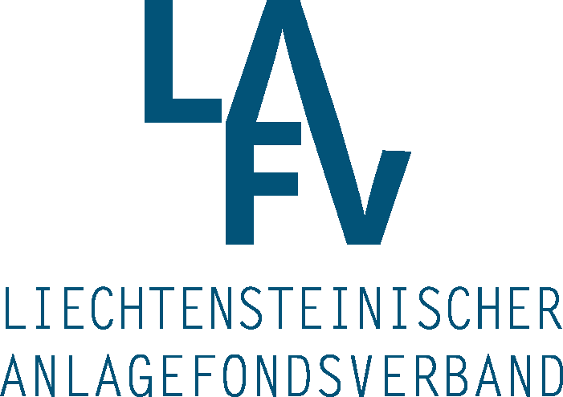
Professional, innovative, internationally-recognised and broadly based Liechtenstein financial centre

Slide 13
Fiduciary companies Securing assets over generations
Expertise and strengths
Asset preservation
Asset structuring
Fiduciary foundation on behalf of the client of foundations, companies and trusts as well as their administration and management
Financial, business and tax consultancy
Accountancy and annual financial statements
Wage settlements
136
fiduciaries
2500
employees
217
fiduciary companies
Liechtenstein Chamber of Fiduciaries
www.thk.li

Slide 14
Banks Banking centre Liechtenstein: Stable, expert and sustainable
Expertise and strengths
Private banking and asset management
International wealth management
Client assets under management (in CHF billion)
11
banks
Liechtenstein Bankers Association
www.bankenverband.li
2925
employees
(excluding non-domestic companies)

Slide 15
Asset management companies Portfolio management and investment consultancy
Expertise and strengths
Asset management / portfolio management
Investment consultancy
Execution of orders in the name of the client
Securities and financial analyses
10 379
client relationships
668
employees
94
asset management
companies
Association of Independent Asset
Managers Liechtenstein
www.vuvl.li
54,2
24,6
Client assets under management of asset management companies (in CHF billion)
Source: FMA
assets under management (AUM) total
assets under management (AUM) in Liechtenstein

Slide 16
Investment fund companies Rising investment fund centre
Expertise and strengths
Fund structure
Fund administration
Innovative concepts
Sustainability
Liechtenstein Investment Fund Association
www.lafv.li

Slide 17
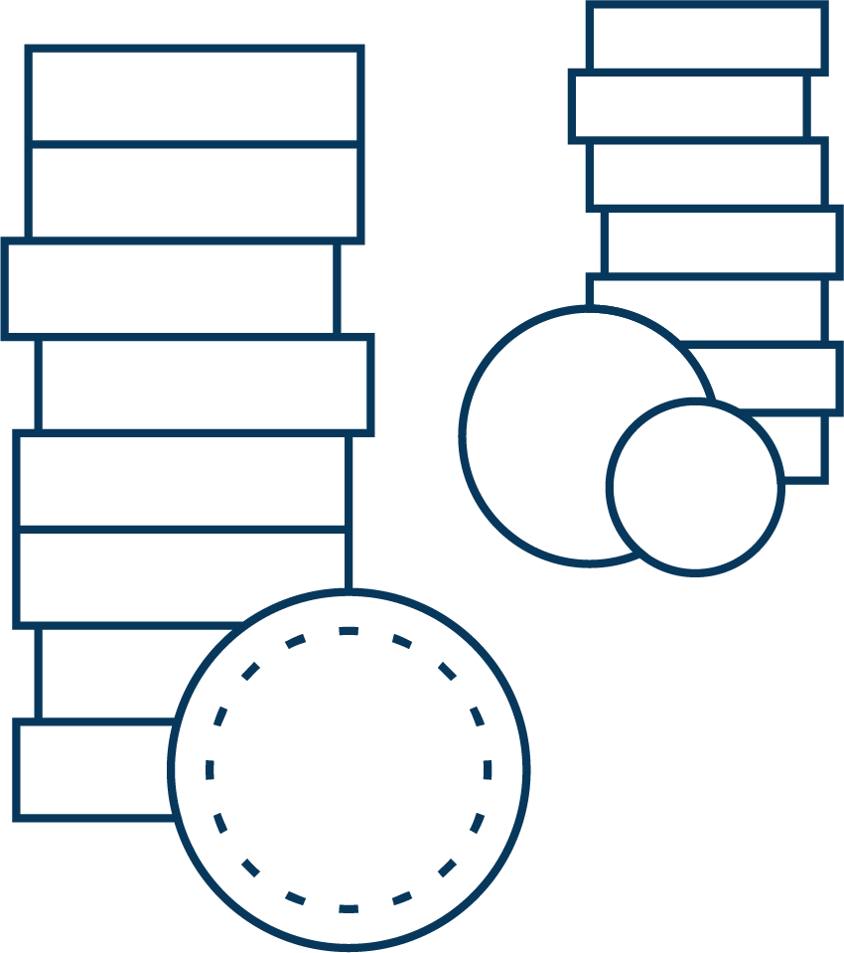
Insurance companies Security today and in the future
Expertise and strengths
Life insurance, non-life insurance and reinsurance
Innovative risk protection
Investment fund and bond-linked pension solutions
Investment products for HNW private clients
International industry insurance
Supplementary per diem health insurance (which in Liechtenstein can also be distributed under the life insurance licence)
15
life insurance
companies
14
non-life insurance
companies
3
reinsurance
companies
32
insurance companies
Liechtenstein Insurance Association
www.lvv.li
1092
employees
5,59
CHF billion gross premium

Slide 18
Auditors Important insurance coverage in a complex, dynamic environment
Expertise and strengths
Independent service providers in all aspects of auditing
All business audits for companies and regulatory audits in accordance with special laws within the scope of Liechtenstein financial market regulation
Important link between the state and the private sector
Supporting the lawful conduct of financial intermediaries
Independent
Organised
Impartial
Conscientious
Discreet
Responsible
Regulated
92
auditors
Liechtenstein
Association of Auditors
www.wpv.li

Slide 19
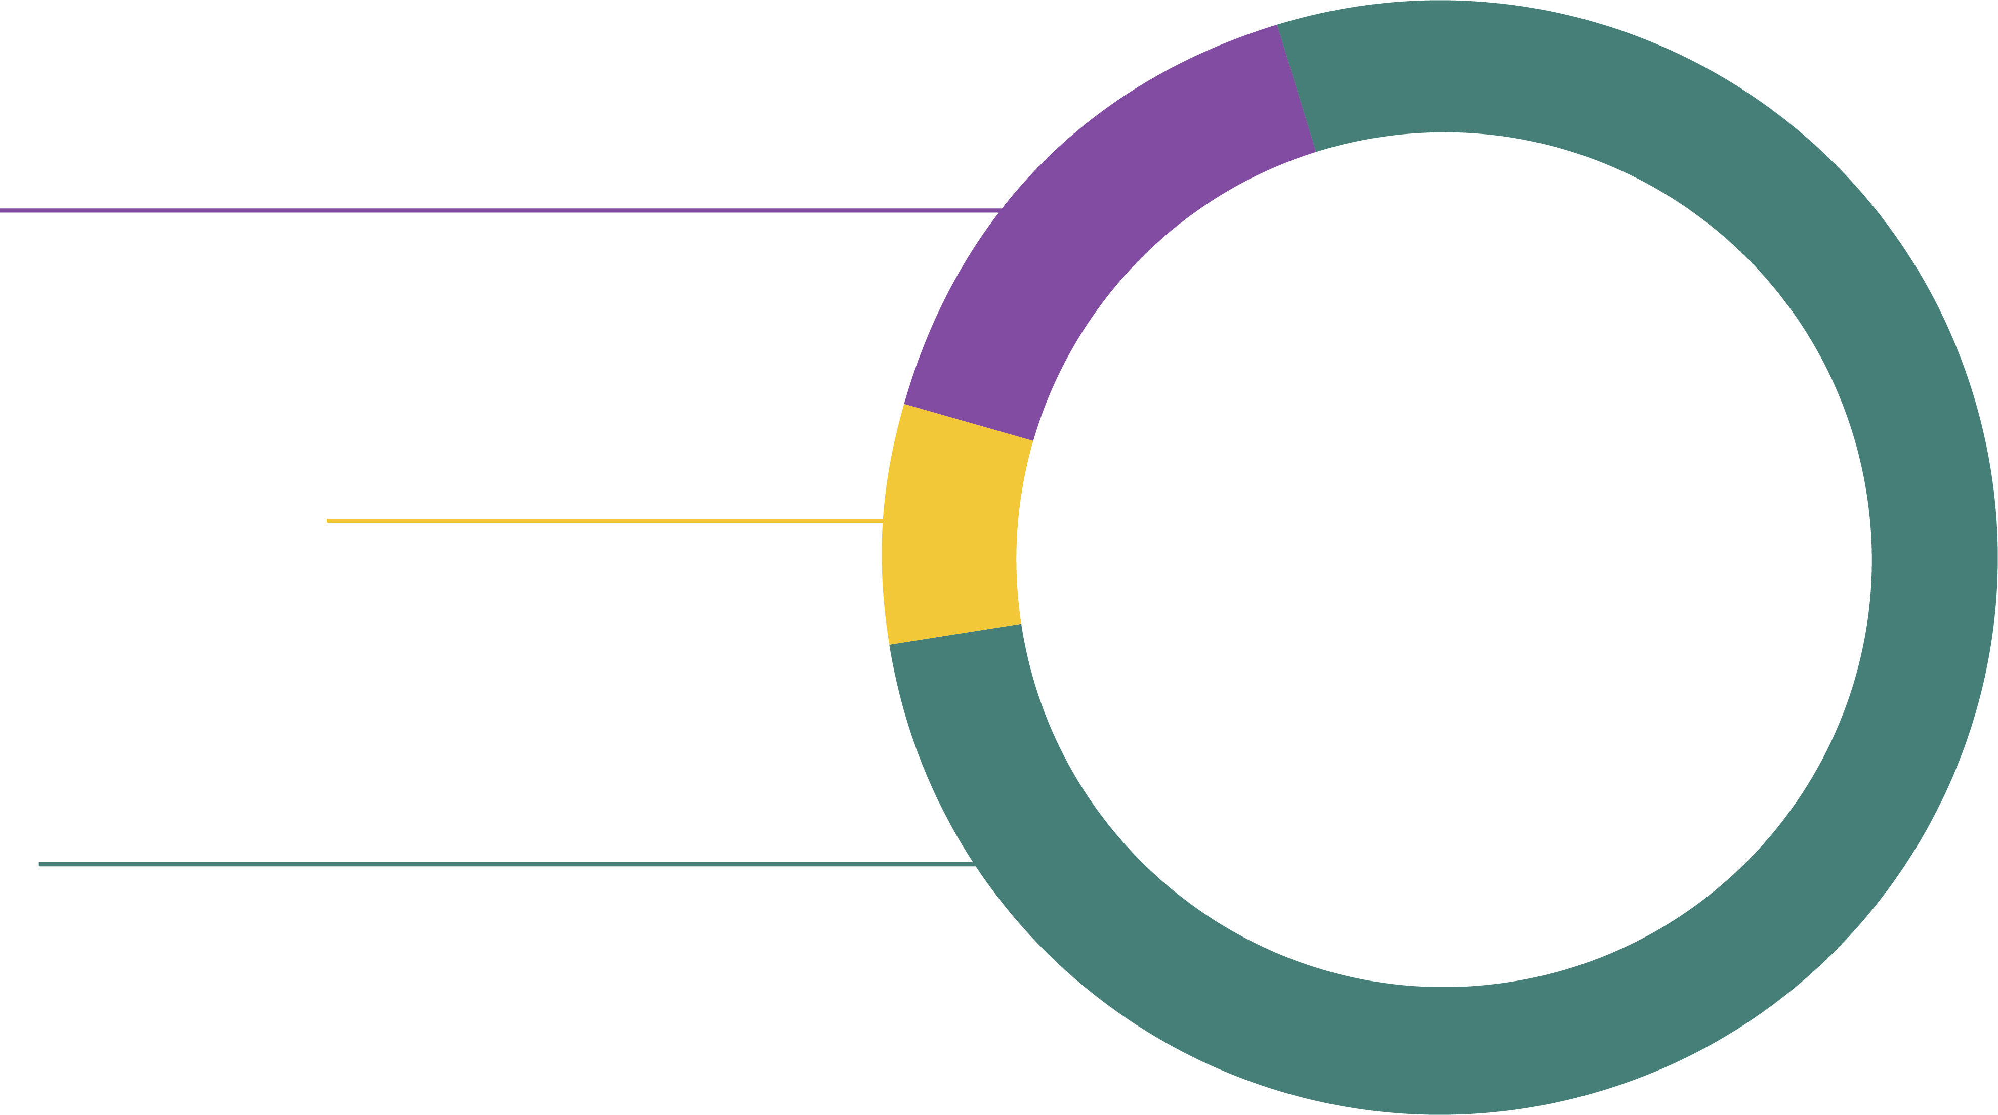
Association of Liechtenstein Charitable Foundations and Trusts (VLGST) Globally committed philanthropy centre Liechtenstein
Expertise and strengths
Extensive freedom of the founder to determine the intended purpose
Effective foundation supervision with efficient and lean administrative processes
Advanced foundation governance with high protection of the private sphere.
No geographical restrictions for the support activity, for the designation of beneficiaries or for the composition of the foundation council
Diverse structures with innovative options such as the protected cell company (PCC)
Geographic scope of
common-benefit foundations
16 %
Switzerland
7 %
Liechtenstein
Breakdown of the support volume according to regions
77 %
International
Association of Liechtenstein Charitable
Foundations and Trusts
www.vlgst.li
Source: Survey of the Association of Liechtenstein Charitable Foundations and Trusts (VLGST) on a voluntary basis (2019)

Slide 20
CFA Society Liechtenstein Highest ethical standards and life-long learning in focus
Expertise and strengths
The CFA Charter (“Dipl. Finanzanalyst”) is the global standard in the field of financial further training
With the “ESG Certificate” the CFA Society promotes and standardises know-how for sustainable investment
Lectures / talks on current financial market topics
Ethics workshops for financial market players
Globally-recognised standards for the financial sector GIPS (Global Investment Performance Standards)
Top 10: Employment of members
CFA Society Liechtenstein
www.cfasociety.org/liechtenstein

Slide 21
Attorneys-at-law Reliable partner for all legal transactions
Expertise and strengths
Advice on all corporate and private legal questions
Support in conjunction with national and international legal questions
Representation in all judicial and out-of-court matters
All legal fields covered – from contract law to blockchain
230
attorneys-at-law
85
legal assistants
(still undergoing
training to become
a lawyer)
46
law firms
Liechtenstein Chamber of Lawyers
www.rak.li
68
licensed European lawyers

Slide 22
Insurance brokers Independent for the client‘s benefit
Competences and strengths
Independent consulting in the selection of suitable insurance products
Relief to insurance providers by carrying out administrative activities
Active market monitoring
Review and monitoring of insurance portfolios on the basis of the willingness and ability to take risks
Link between client and insurance
51
Registered insurance brokers in Liechtenstein
Liechtenstein Insurance Brokers Association
www.liba.li

Slide 23
TT Service Providers Legal certainty today for tomorrow‘s technology
Competences and strengths
Since 2020, the TVTG has set a legal framework for the rendering of services in the field of trustworthy technologies and has thus provided legal certainty, regulating not only digital assets but also the tokenistion of analogue assets
As a result of the combination of the TVTG and the possibility of EU passporting for instruments regulated by financial market laws, Liechtenstein offers a unique framework for implementing digital services in Europe
The Government’s Office for Financial Market Innovation and Digitisation supports and promotes the further development of conditions for innovation at the Liechtenstein financial centre
22
Registered TT enterprises
48
Registered TT services
CCA Trustless Technologies Association e.V.
www.tt-association.li

Slide 24
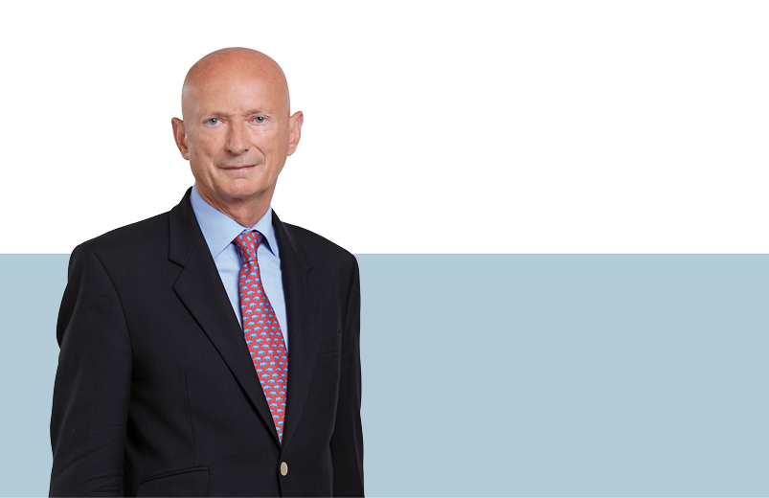
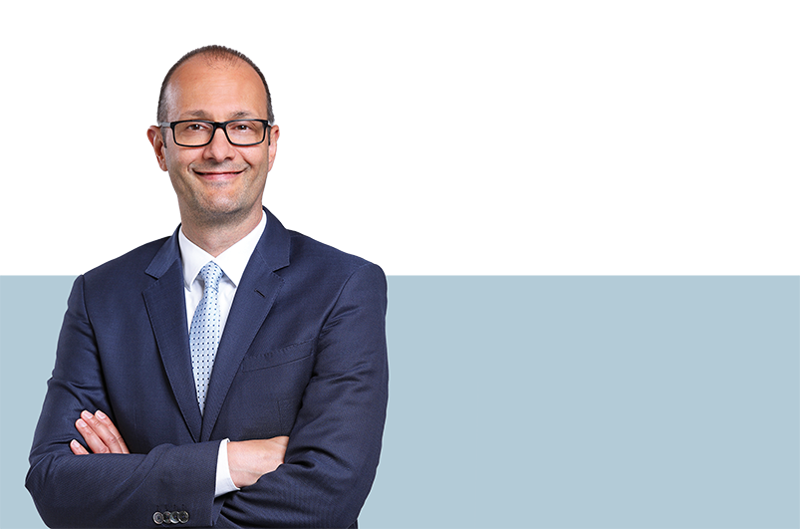
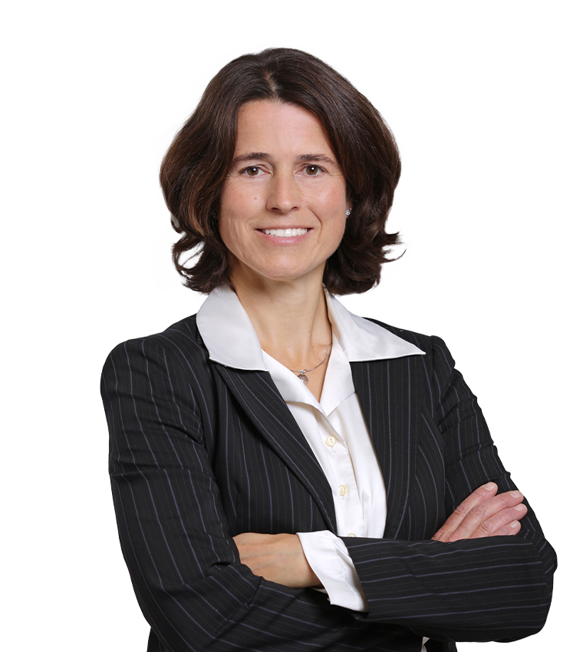
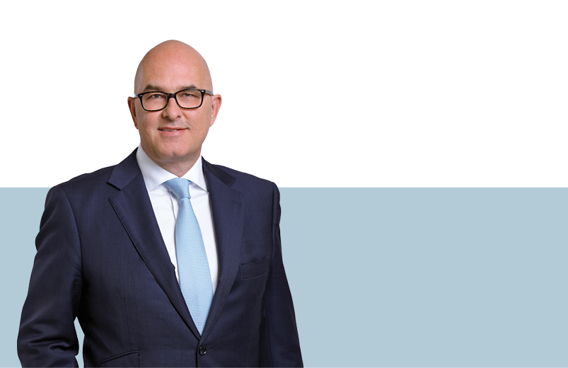
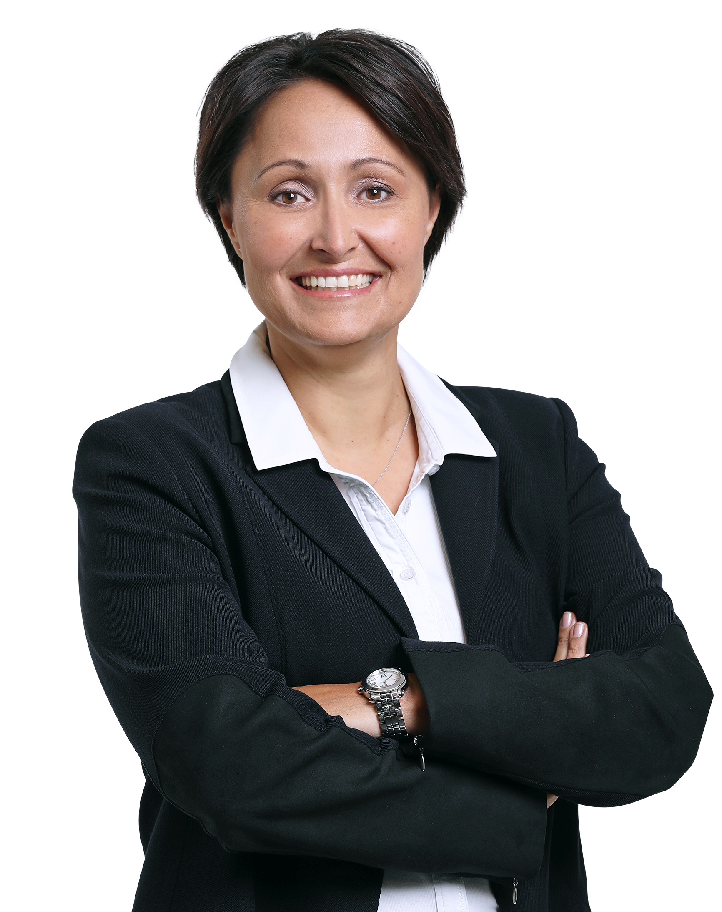
Verein
Management Board
Nicole Bays (80%)
Board of Directors
S.D. Prinz Michael von und zu Liechtenstein
Chairman of the Board of Directors
Simon Tribelhorn
Management Board
Tanja Muster (40%)
Board of Directors
Marcel Müller
Board of Directors
Roland Moser

Slide 25
Thinking in generations
finance.li

